Slide 1
Project Name
Cancer Data Analysis
Presented By
Ankita Kheto
Domain
Data Analysis
Tools Used
Python
Key Metrics
Total Patient
10000
Average Patient Age
53
Total Recover Patient
4931

Slide 2
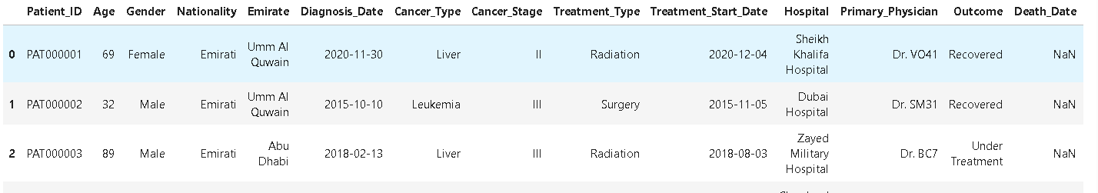
Dataset Overview
Total Rows
10000
Total Columns
20
Column Name
State , Rating Count Patient_ID,Age,Gender,Nationality,Emirate,Diagnosis_Date,Cancer_Type,Treatment_Type,Treatment_Start_Date,Hospital,Primary_Physician,Outcome,Death_Date,Cause_of_Death,Smoking_Status,Comorbidities,Ethnicity,Weight,Height
Data Source
Kaggle – Cancer Dataset

Slide 3
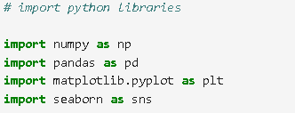



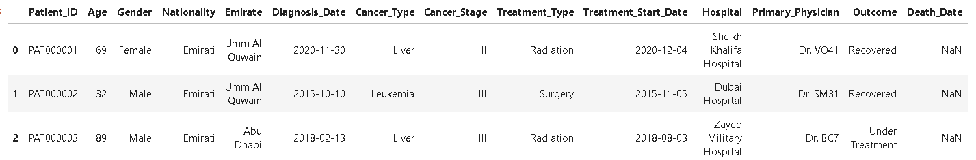

Insight
Import Python Libraries
Import Dataset using pandas
Dataset size (Rows Columns)
Top Records Preview

Slide 4
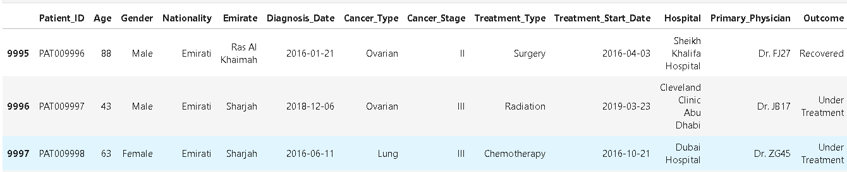


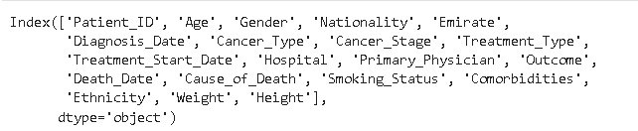
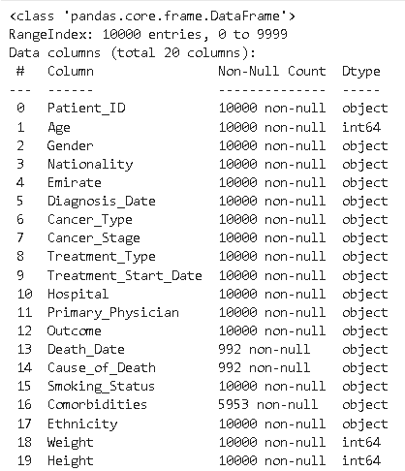


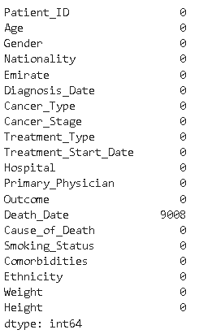
Insight
Bottom records Preview
Checked all column name in dataset
Data information Overview
Missing values analysis

Slide 5
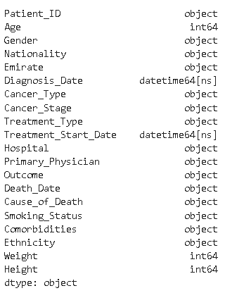
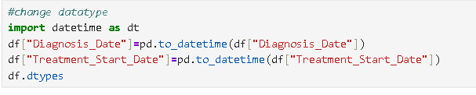
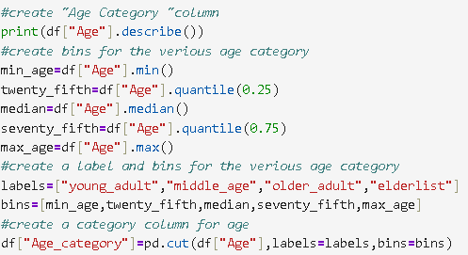
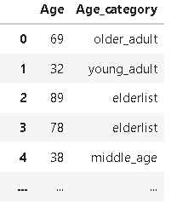
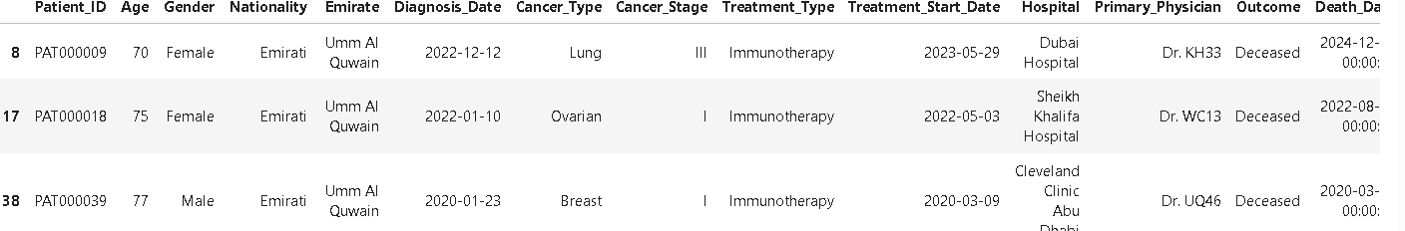

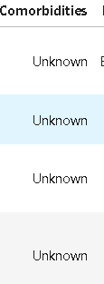

Insight
Converted Diagnosis _ date and Treatment _ Start _ date column to Datetime Format
Create Age Category column for properly analysis
Check which patient are death.
Fill the missing values using fillna

Slide 6
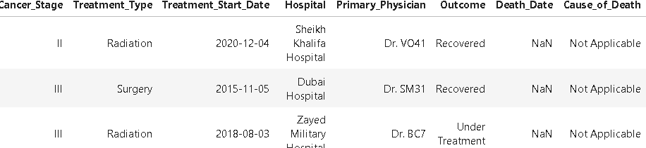
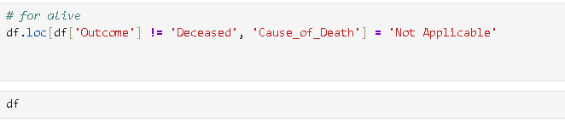
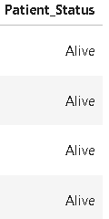

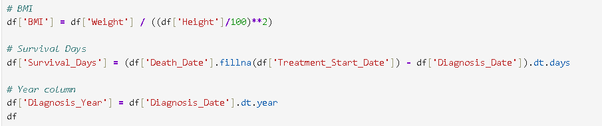
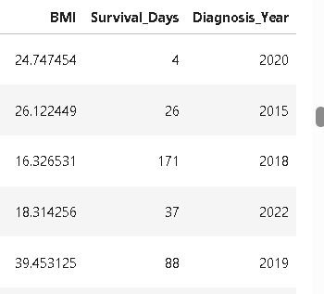
Insight
Cleaned the dataset by marking "Cause of Death" as "Not Applicable" for alive patients to improve data accuracy and ensure meaningful mortality analysis.
Create column Patient Statues for better analysis and see that which are dead and which are alive .
Create column BMI and Survival day and Diagnosis Year For better analysis.

Slide 7
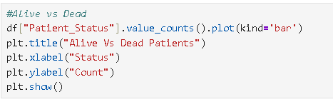
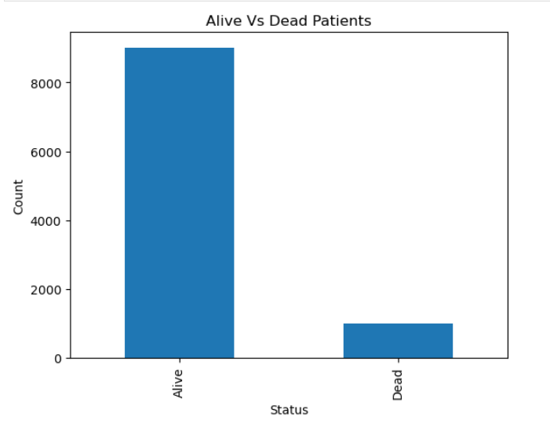
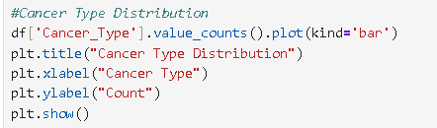
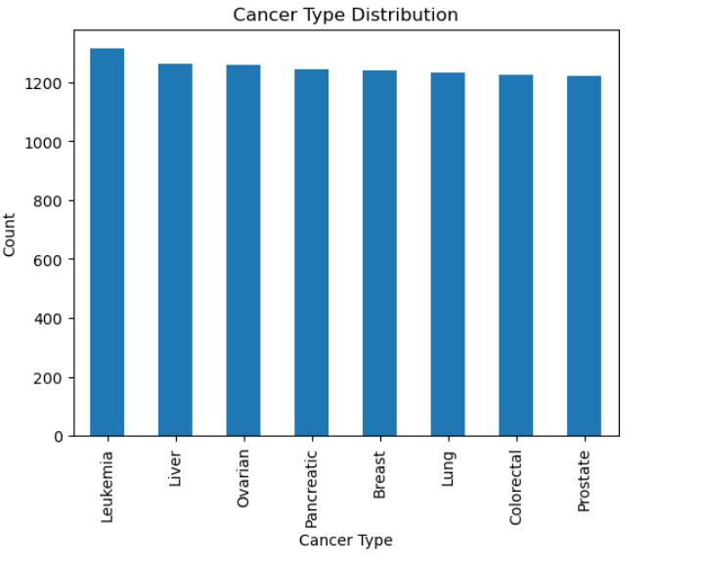
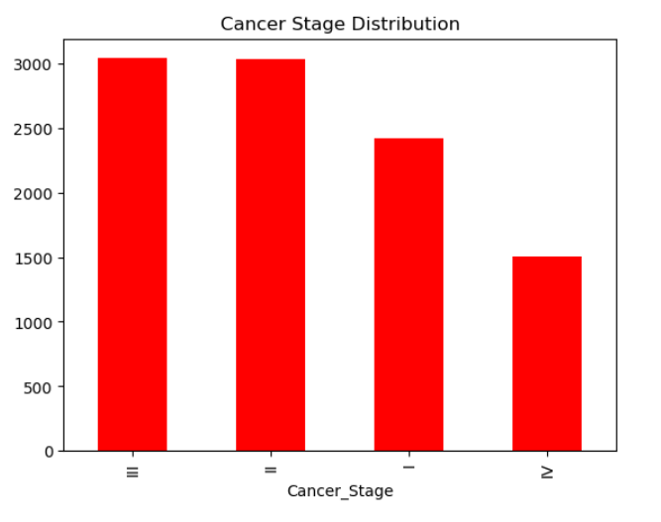
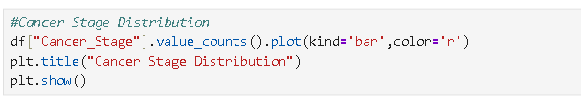
Charts
Insight
The bar chart shows that alive patients are higher than deceased patients, indicating a positive survival rate and effective treatment outcomes.
The chart shows the distribution of different cancer types, highlighting the most common cancers among patients. This helps in resource planning, treatment focus, and early detection programs
The chart shows the distribution of patients across cancer stages, helping to assess early detection effectiveness and identify areas for improving diagnosis and treatment strategies..

Slide 8
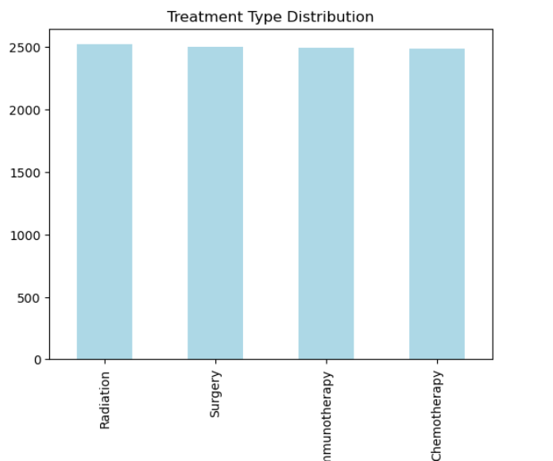

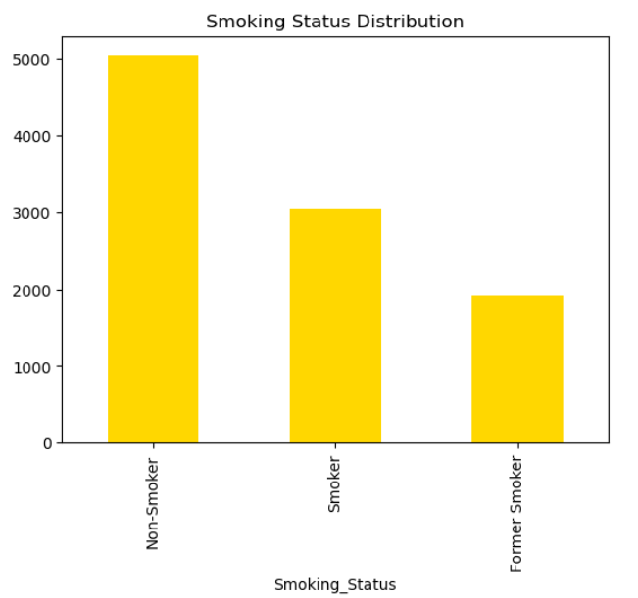

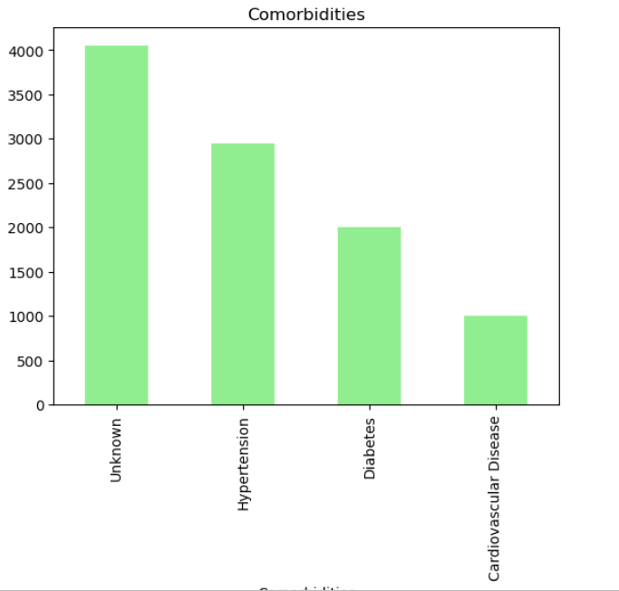
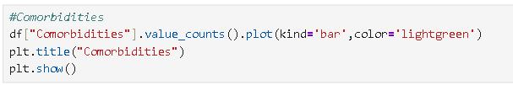
Insight
The chart highlights the distribution of treatment types, showing the most commonly used therapies and helping in resource planning and treatment optimization.
The smoking status distribution shows the proportion of smokers and non-smokers among cancer patients, helping to understand smoking as a potential cancer risk factor.
The dataset includes officially verified medical inspection records with certification details, which help track inspection history and ensure compliance.

Slide 9
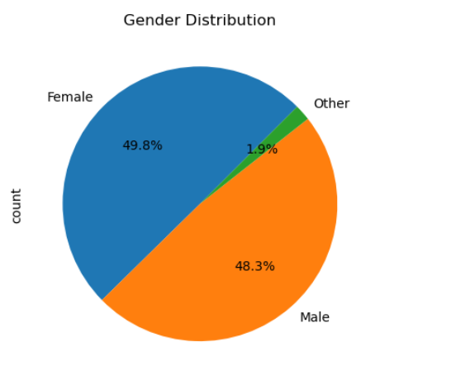
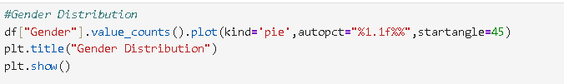

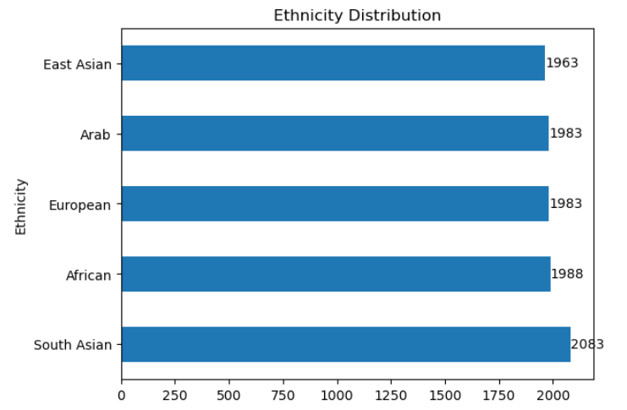
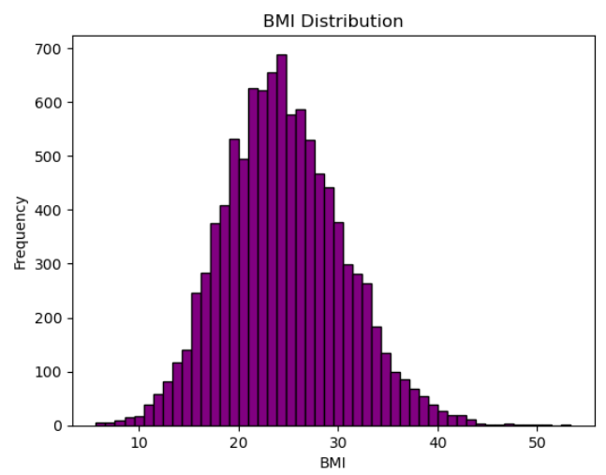
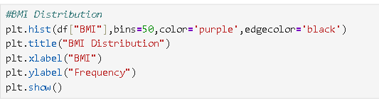
Insight
The gender distribution shows the proportion of male and female patients, helping identify which group is more affected and enabling targeted healthcare planning
The ethnicity distribution shows cancer cases across different ethnic groups, helping identify high-risk populations and plan targeted screening and awareness programs.
The BMI distribution shows patient weight categories and helps analyze obesity as a potential cancer risk factor..

Slide 10
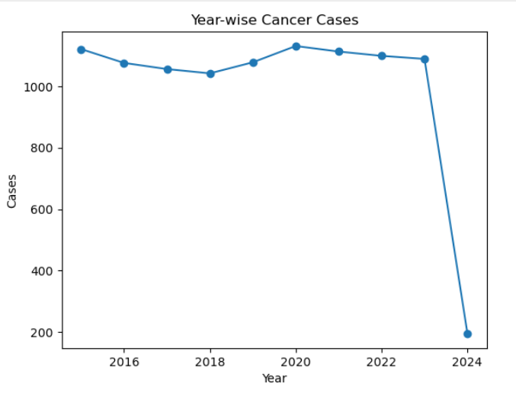
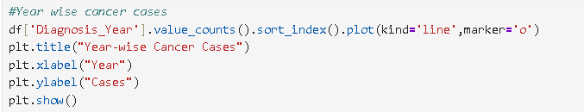

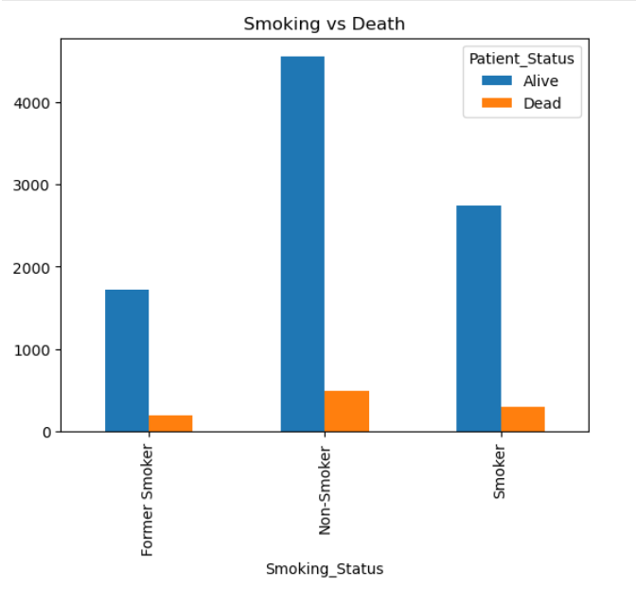
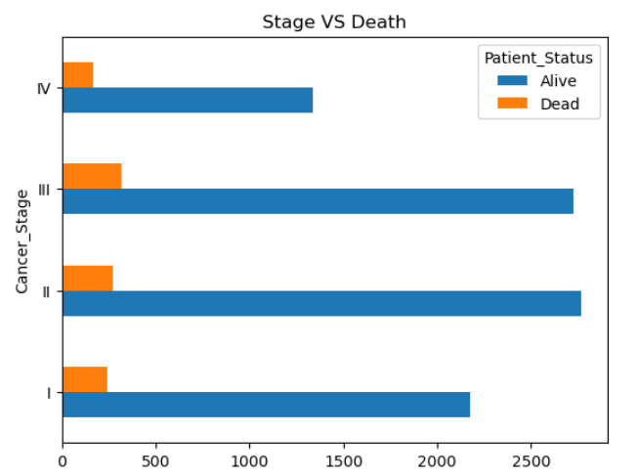
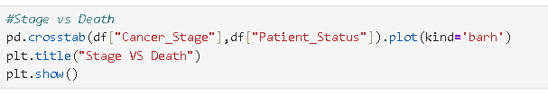
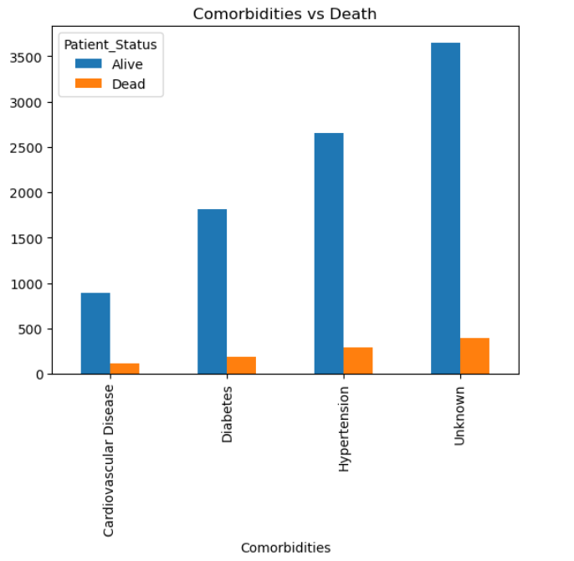

Insight
The year-wise trend shows how cancer cases have changed over time, helping identify trends, plan resources, and improve early detection programs.
The analysis shows that smokers have a higher mortality rate compared to non-smokers, indicating smoking as a major risk factor affecting cancer surviva
The analysis shows that mortality is higher in advanced cancer stages, while early-stage diagnosis has a higher survival rate, highlighting the importance of early detection..
Patients with comorbidities have a higher mortality rate, indicating that existing health conditions increase cancer risk and complications

Slide 11
.
Recommendations
The hospital should focus on early cancer detection and screening programs, as early-stage diagnosis increases survival rate.
Smoking awareness programs should be implemented to reduce cancer risk among patients.
Special attention should be given to high-risk patients such as smokers, obese patients, and patients with comorbidities.
The hospital should improve treatment facilities for advanced-stage cancer patients to reduce mortality.
More resources and medical support should be allocated to the most common cancer types.
The hospital should promote healthy lifestyle programs such as proper diet, exercise, and regular health checkups.
Data analytics dashboards should be used for continuous monitoring and better decision-making.

Slide 12
Thank you

